Slide 1


SOFTWARE Design & Analysis (Week-1)
Usama Musharaf
MS-CS (Software Engineering)
Lecturer (Department of Computer Science)
FAST-NUCES Peshawar

Slide 2
Course Content
Principles of Object Technology. OOP Review. Principles of Modeling.
OOA&D Overview. OO Development Process.
Requirements Engineering, Analysis, and Specification: Requirements Engineering, Use Cases, Prototyping,
Class Models. Interaction Diagrams. Verification and Validation.
Architectural and Detailed Design.
Class Diagrams. Interaction Diagrams. State Machines and Diagrams. Implementation, Package Diagrams. Activity Diagrams.
OO Patterns,
Verification and Validation.
Note: Students may also be introduced to Object Diagram, Component Diagram, Package Diagram, Deployment Diagram, Network Diagram.

Slide 3
Recommended Books
Recommended Books
1. Applying UML and patterns: An introduction to Object-Oriented Analysis and Design and Iterative Development by Craig Larman, Prentice Hall; 3rd Edition (October 30, 2004). ISBN-10: 0131489062
2. Using UML: Software Engineering with Objects and Components by Perdita Stevens, Addison-Wesley; 2nd Edition (February 13, 2006). ISBN-10: 0321269675
3. Fundamental of Object-Oriented Design in UML by Meiler Page-Jones, Addison Wesley, 2000. ISBN: 020169946X.
4. The Unified Modeling Language User Guide by G. Booch, J. Rambaugh and I. Jakobson, Addison-Wesley Professional; 2nd Edition (2005). ISBN- 10: 0321267974.

Slide 4
Objective of this Course
The course will start with requirements gathering, & end with implementation in object oriented programming language.(JAVA)

Slide 5
Evaluation Criteria
Assessment | Weightage
Assignment | 10%
Quiz | 10%
Project | 10%
Sessional 1 | 15%
Sessional 2 | 15%
Final Exam | 40%

Slide 6
Weekly plan
Week | Topics
Week 1 - 5 | Intro to Software Design and Analysis, Brief overview of Software Engineering Phases, Problems in Software Development, Software Design Process, Difference between Design and Architecture, Software Process Models. Software Requirement Engineering, Structure Analysis Requirement Engineering (Cont…), Analysis Modeling, Object Oriented Analysis, Modeling with UML (Static and Dynamic Models), Design Principles and Concepts Design Principles and Concepts (Cont..), Object Oriented Design Concepts, Object Oriented Design with a Case Study, Case Study with in depth Requirement Analysis & Design

Slide 7
Weekly plan
Week | Topics
Week- 6 - 9 | Software Development Intro to Java Programming, Environment Setup, Basic Syntax and Programming language constructs. Control Structures, Arrays, Multi-Dimensional Arrays, Practice with some small case studies. Software Development (Design Mapping to Code) Object-Orientation, Classes , Objects. Constructors. Class Association (Inheritance), Polymorphism, Object Association (Composition, Aggregation), Abstract Classes, Interfaces, SOLID Principles-Hands-on. Exception Handling,
Week 10 - 12 | GUI, Graphical User Interface Design in Java, Event Driven Programming in Java, Database Connectivity
Week 13 - 15 | Problem Solving Using Design Patterns, Software Design Patterns, Design Patterns Implementation in Java.

Slide 8
Agenda of week # 1
Intro to Software Design and Analysis,
Brief overview of Software Engineering Phases,
Software Design Process,
Difference between Design and Architecture,
Problems in Software Development

Slide 9
Software can have huge impact in any aspect of our society

Slide 10
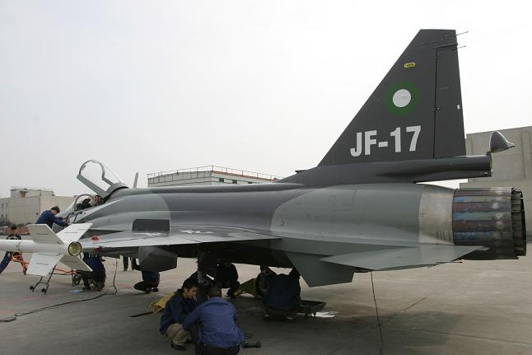
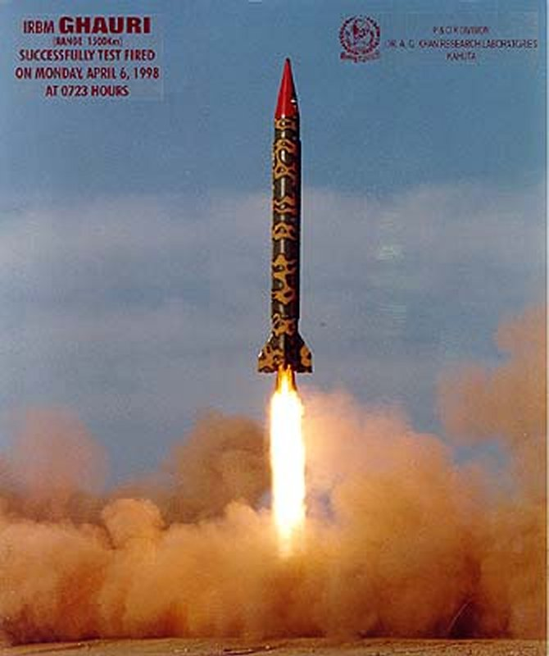
Where can we find software?

Slide 11
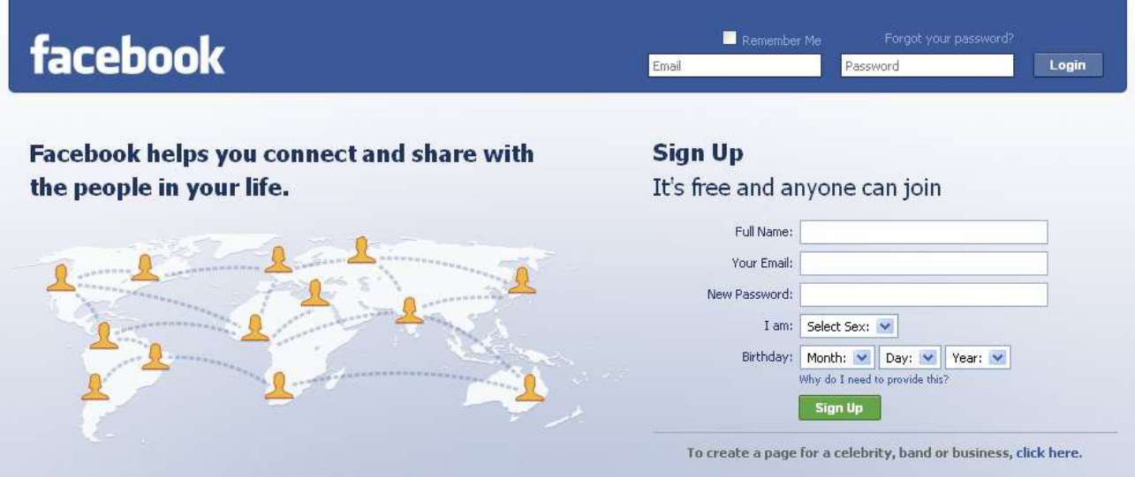
Some popular ones…

Slide 12

Some popular ones…

Slide 13


And even in…

Slide 14
Conclusion
Software is almost everywhere!!!

Slide 15
Software Applications
Personal Computer Software
Business Software
System Software
Real Time Software
Engineering & Scientific Software
Embedded Software
Web Based Software
Artificial Intelligence Software

Slide 16
Problems in software development
Common issues
The final software does not fulfill the needs of the customer
Hard to extend and improve: if you want to add a functionality later its mission impossible
Bad documentation
Bad quality: frequent errors, hard to use, ...
More time and costs than expected

Slide 17
A clever person solves a problem.
A wise person avoids it.
- Albert Einstein

Slide 18
Solution Software Engineering

Slide 19
SE history
SE introduced first in 1968 – conference about “software crisis” when the introduction of third generation computer hardware led more complex software systems then before.
Early approaches based on informal methodologies leading to
Delays in software delivery
Higher costs than initially estimated
Unreliable, difficult to maintain software
Need for new methods and techniques to manage the production of complex software.

Slide 20
What is Software Engineering?
Systematic approach for developing software
Methods and techniques to develop and maintain quality software to solve problems.
Study of the principles and methodologies for developing and maintaining software systems.

Slide 21
What is Software?
According to the IEEE
Software is:
“Computer programs, procedures, and possibly associated documentation and data pertaining to the operation of a computer system”.

Slide 22
The Role of Software Engineering
A bridge from customer needs to programming implementation
Customer
Software Engineering
Programmer
First law of software engineering
Software engineer is willing to learn the problem domain
(problem cannot be solved without understanding it first)

Slide 23
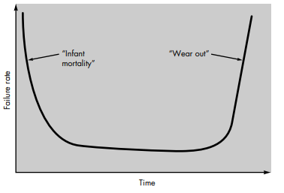
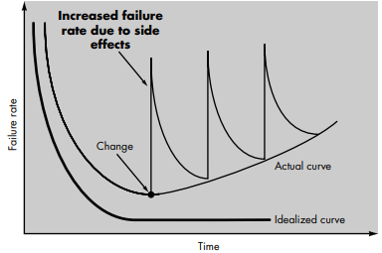
Hardware vs software
Failure curve for hardware
Idealized and actual failure curves for software

Slide 24
What are the attributes of good software?

Slide 25
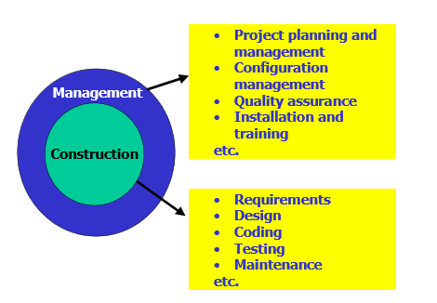
Software Development

Slide 26
Software Engineering Phases
Definition: What?
Development: How?
Maintenance: Managing change
Umbrella Activities: Throughout lifecycle

Slide 27
Definition
REQUIREMENTS DEFINITION AND ANALYSIS
Developer must understand
Application domain
Required functionality
Required performance
User interface

Slide 28
Definition (cont.)
Project planning
Allocate resources
Estimate costs
Define work tasks
Define schedule
System analysis
Allocate system resources to
Hardware
Software
Users

Slide 29
Development
SOFTWARE DESIGN
User interface design
High-level design
Define modular components
Define major data structures
Detailed design/Low level Design
Define algorithms and procedural detail

Slide 30
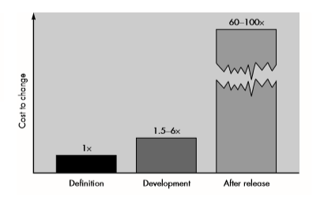
Why is software development so difficult?
Changing requirements
5 x cost during development
up to 100 x cost during maintenance

Slide 31
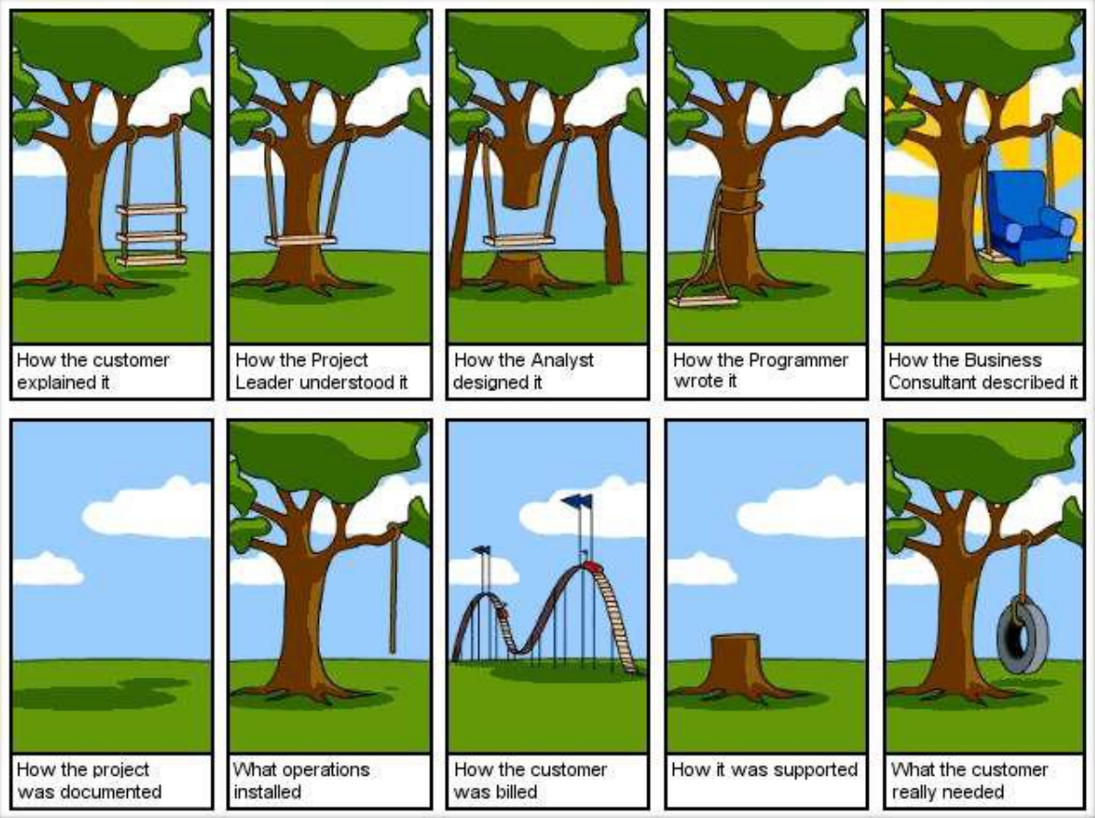
Major problems in software developments

Slide 32
What is Design?

Slide 33
What is Design?
Design is the first step in the development phase for any engineered product or system.
Design is about HOW the system will perform its functions.

Slide 34
Software Design
A software design is a meaningful engineering representation of some software product that is to be built.
“The process of applying various techniques and principles for the purpose of defining a device, a process or a system in sufficient detail to permit its physical realization”.

Slide 35
Software Design - Simplified
Requirements specification was about the WHAT the system will do
Design is about the HOW the system will perform its functions
provides the overall decomposition of the system.
allows to split the work among a team of developers.
also lays down the groundwork for achieving non-functional requirements (performance, maintainability, reusability, etc.)

Slide 36
Design Process Activities
Architectural design
Modules, inter-relationships etc
Abstract specification
Services of each sub-system, constraints etc
Interface design
Interface to other sub-system or outside environment
Component design
Services allocated to components and their interfaces designed
Data structure design
Algorithm design

Slide 37
The Software Design Process

Slide 38
Levels of Software Design
Architectural design (high-level design)
architecture - the overall structure, main modules and their connections
addresses the main non-functional requirements (e.g., reliability, performance)
hard to change
Detailed design (low-level design)
the inner structure of the main modules
detailed enough to be implemented in the programming language

Slide 39
Design vs. Architecture
Architecture is concerned with the selection of architectural elements, their interaction, and the constraints on those elements and their interactions
Design is concerned with the modularization and detailed interfaces of the design elements, their algorithms and procedures, and the data types needed to support the architecture and to satisfy the requirements.
Architecture…is specifically not about…details of implementations (e.g., algorithms and data structures.)

Slide 40
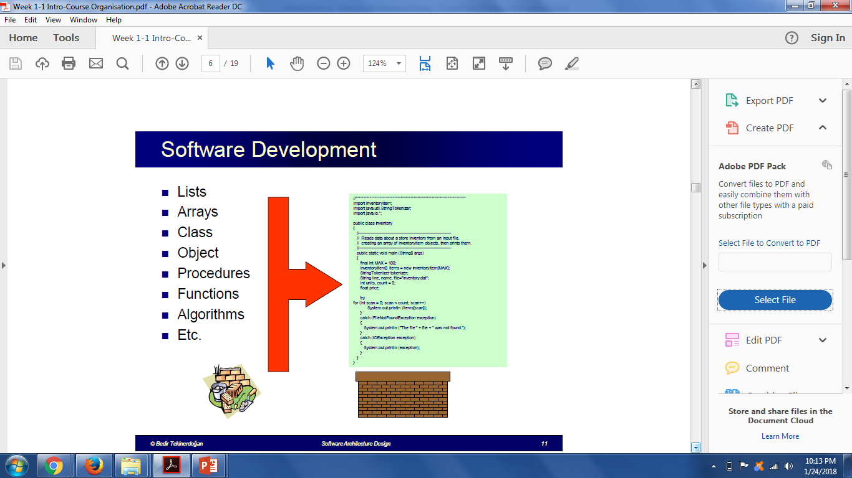

Slide 41
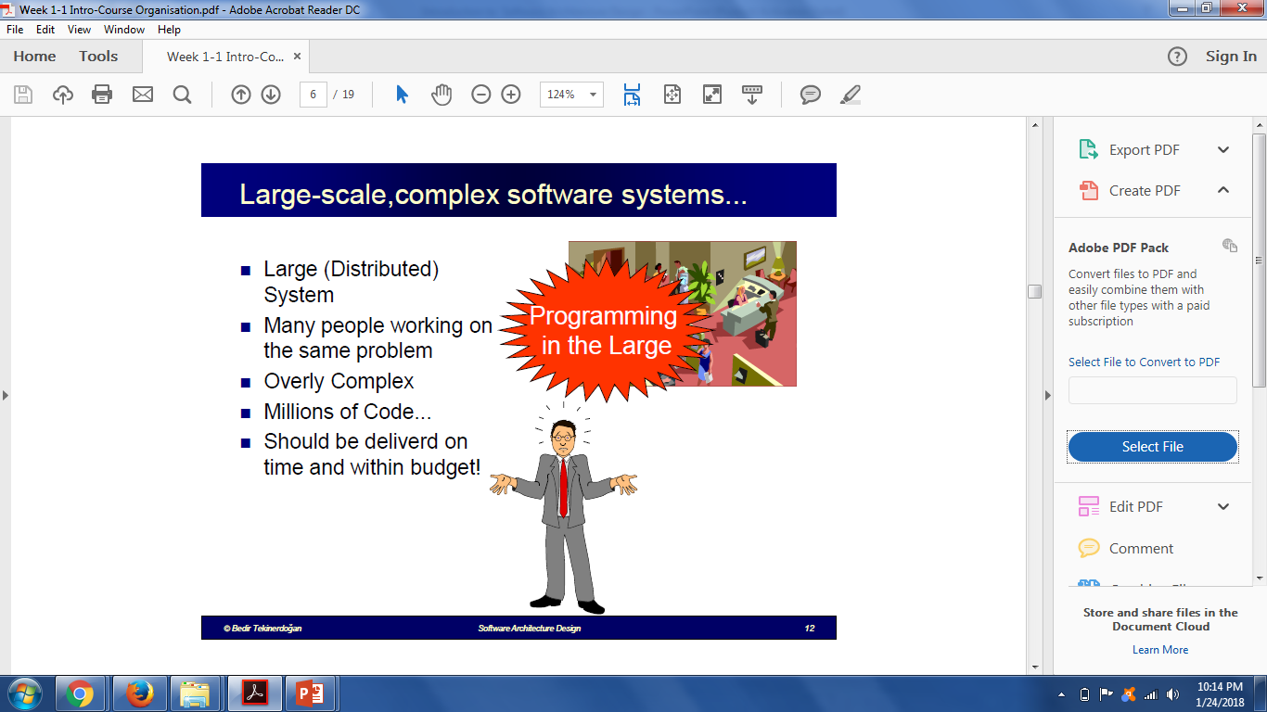

Slide 42
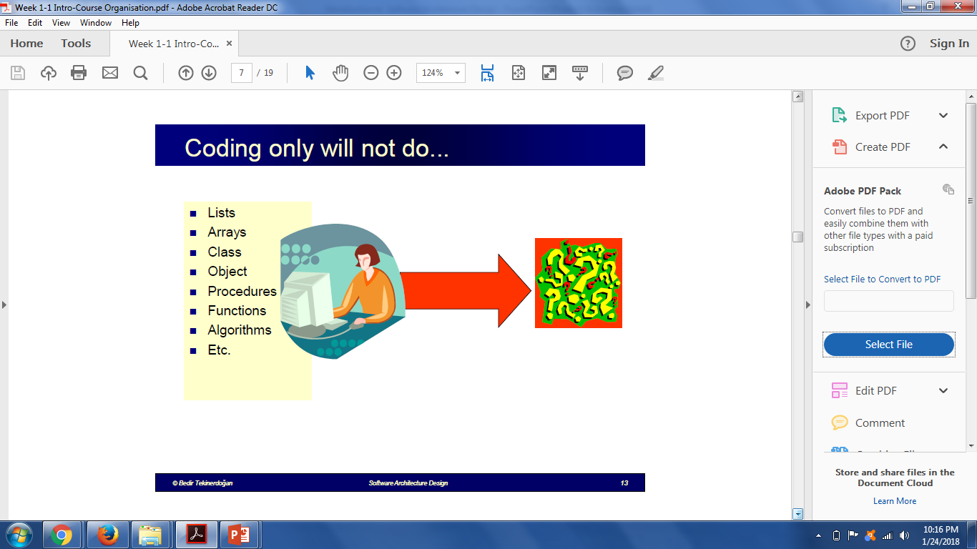

Slide 43
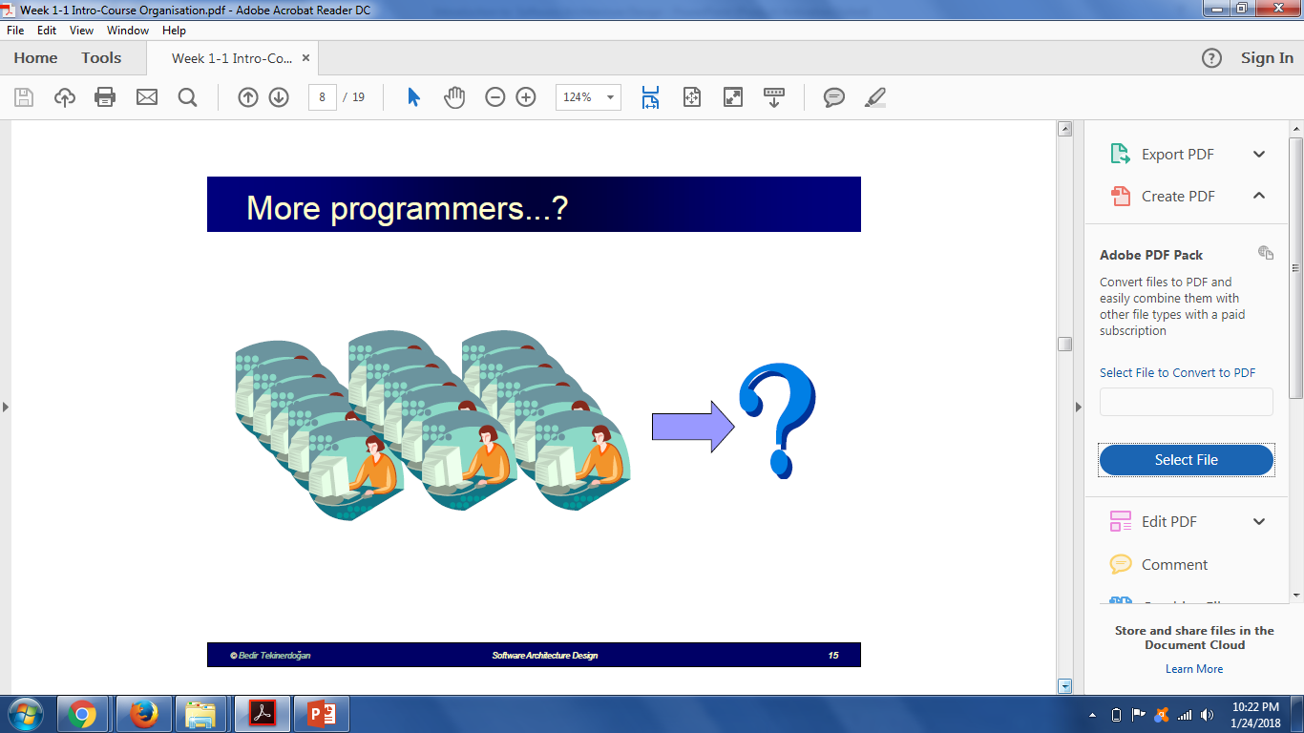

Slide 44
Software Architecture
The software architecture of a program or computing system is the structure or structures of the system, which comprise software components, the externally visible properties of those components, and the relationships between them.

Slide 45
HAVE A GOOD DAY!

